Slide 1
Exercise 2
Interpreting a human genome
Ady Stein, Ohad Edelstein, Ofir Nesher
June 2021

Slide 2
Technology

Slide 3
Technology
The technology used is sequencing microarrays
Total of 960587 loci in file
Report costs 39$ → 0.0041 cents per SNP

Slide 4
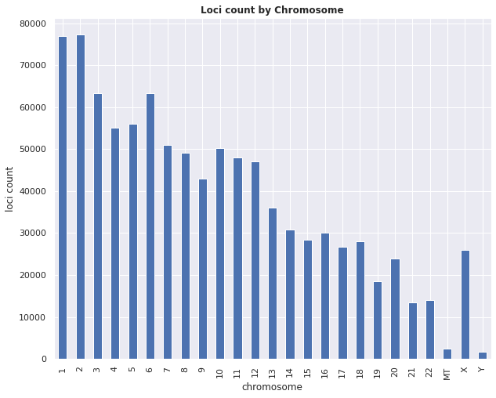

Slide 5
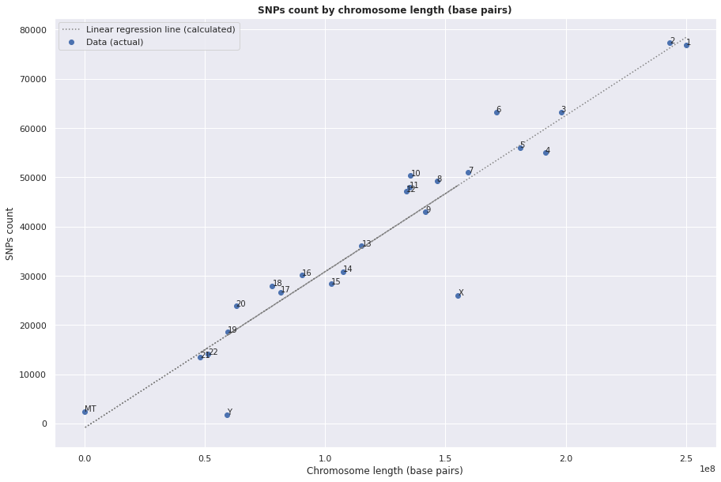
The R² between chromosome length and SNPs count for it is 0.894
Notes:
Are there over-represented or under-represented chromosomes?
The X and Y chromosomes are clearly under-represented.
Albeit depending on our definition (what deviation we consider to be significant), we could also say that chromosomes 6, 10 are over-represented, and to a lesser degree also 11, 12- in which case we would also consider chromosome 4 as under-represented.

Slide 6
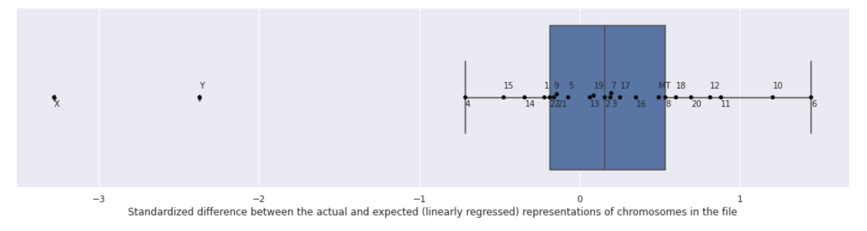
Over and under representation of the chromosomes

Slide 7
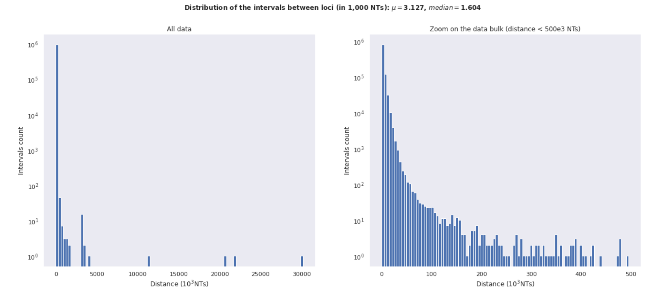

Slide 8
Data

Slide 9
Data
0.3% of the loci are no call (--)
The CC genotype is the most prevalent, but GG is a close second
70.03% of the SNPs are homozygous
This person is a male (has the Y chromosome)

Slide 10
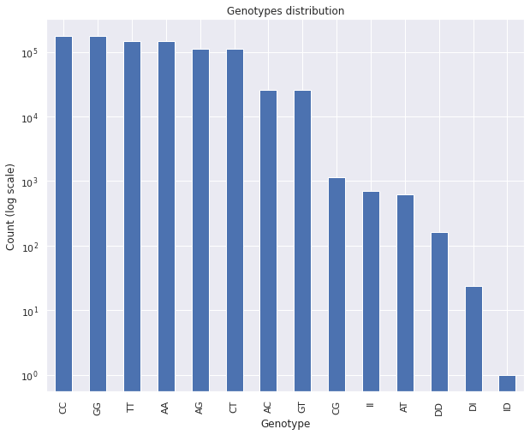
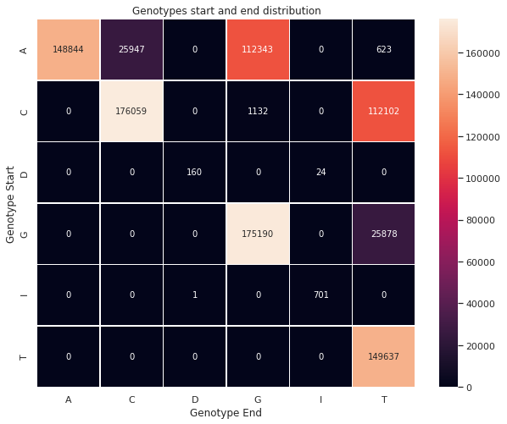

Slide 11
Health

Slide 12
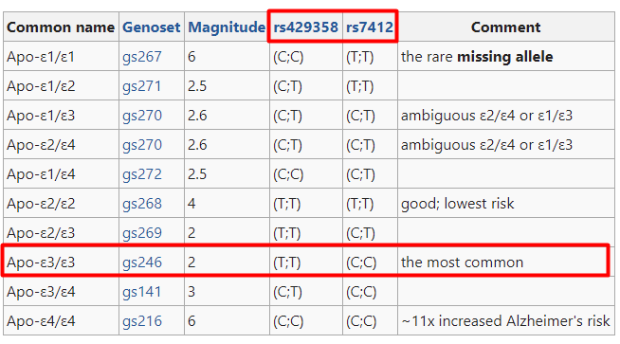
Health - ApoE
"The most common variant overall is the "standard" ApoE-ε3, and therefore more people inherited one ApoE-ε3 from each parent than any other of the possible pairs of variants".
APOE3 is the most common and not believed to affect Alzheimer’s risk*
* https://www.nia.nih.gov/news/study-reveals-how-apoe4-gene-may-increase-risk-dementia#:~:text=APOE3%20is%20the%20most%20common,of%20fat%20in%20the%20bloodstream

Slide 13
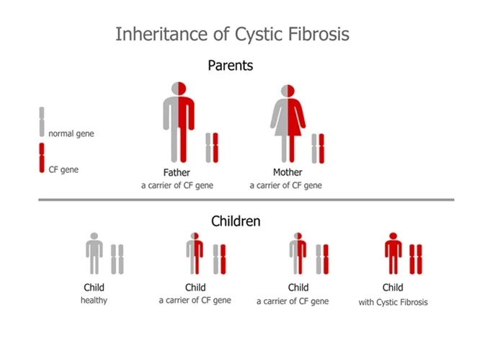
Health - Delta F508
The person has one mutation of the CF gene (D = deletion) and is therefore a CARRIER.
Note: This mutation only accounts for 66%–70% of the CF cases worldwide. There are over 1500 other known mutations that can produce CF.

Slide 14
Scaling Up

Slide 15
Scale Up
From OpenSNP.org - latest 100 genomes from 23andMe
ApoE status | #
Apo-ε3/ε3 (the most common) | 60
Apo-ε3/ε4 | 22
Apo-ε2/ε3 | 8
Unknown | 6
Apo-ε4/ε4 (~11x increased Alzheimer's risk) | 3
Apo-ε2/ε2 (good; lowest risk) | 1
Delta F508 status | #
II | 96
-- | 2
DI | 1
Unknown | 1
-- : no call loci Unknown: loci could not be retrieved from file

Slide 16
GEDmatch

Slide 17
GEDmatch
Used KitID SE1634478 (the base of the “duplicate” genom file we uploaded).
According to gedmatch - compare parents, the parents of this person are “probably not related in recent generations”.
The closest match to this person is KitID M916841: avizov.boris@gmail.com
They share a total of 249.4 cM

Slide 18
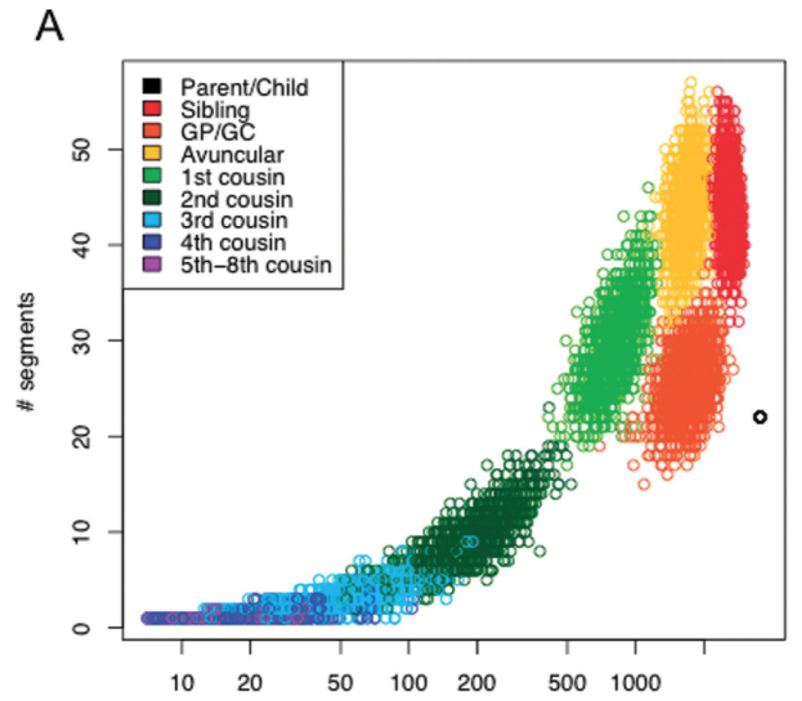
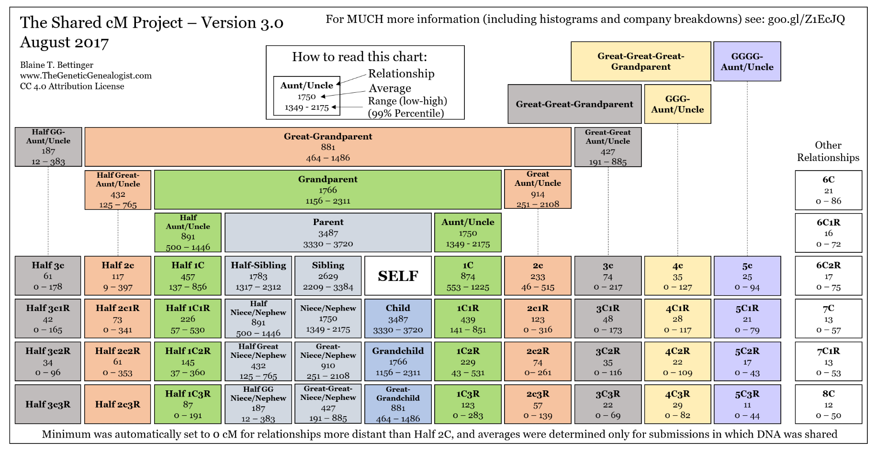
SE1634478 and avizov.boris@gmail.com
*
* https://thegeneticgenealogist.com/wp-content/uploads/2017/08/Shared_cM_Project_2017.pdf

Slide 19
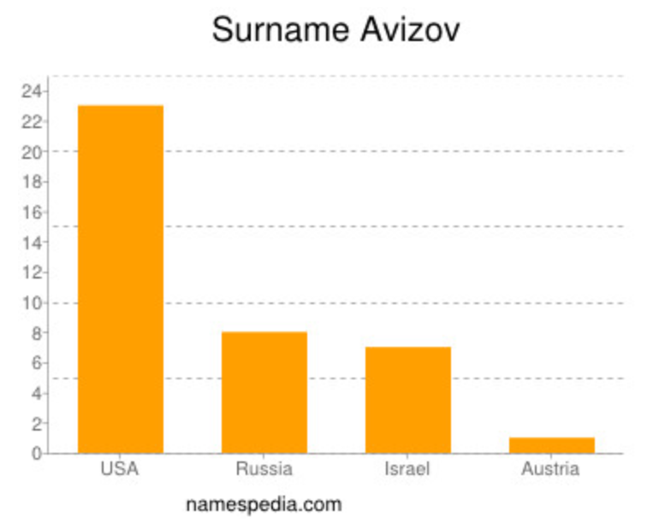
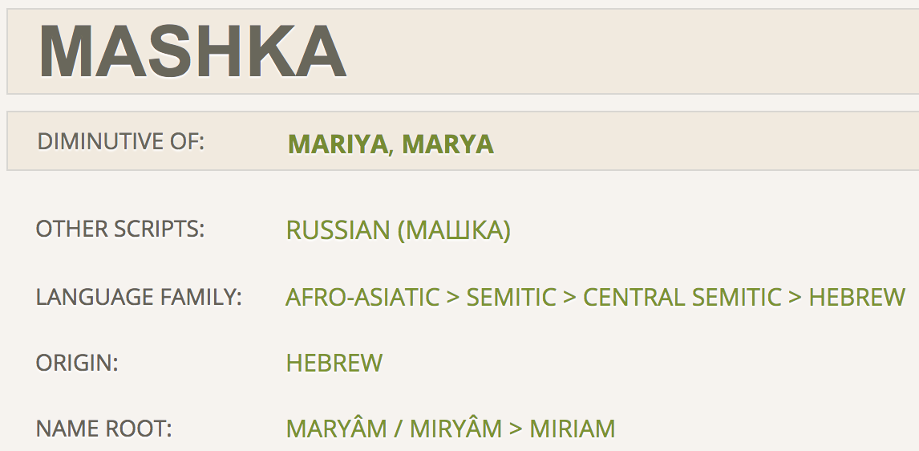
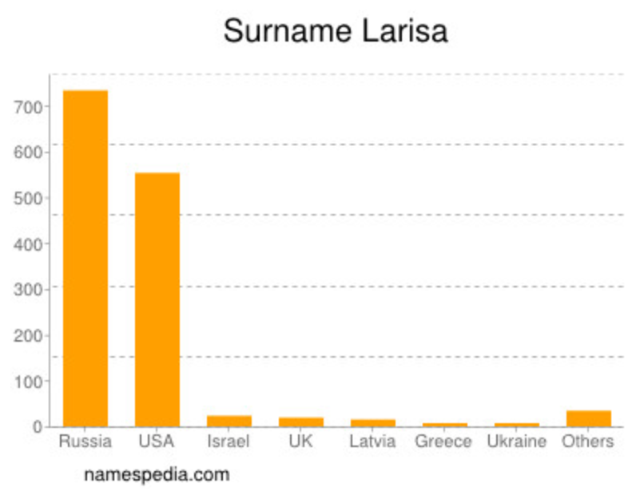
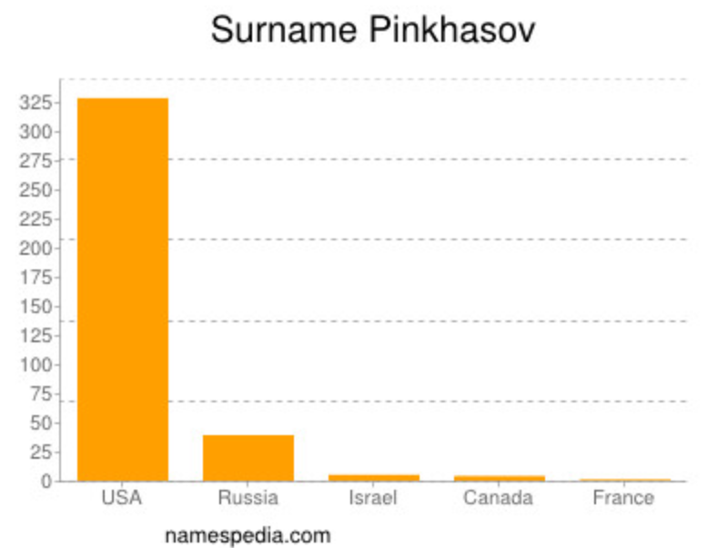
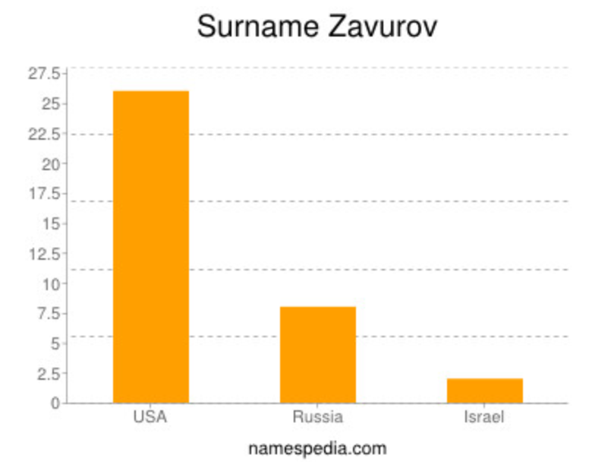
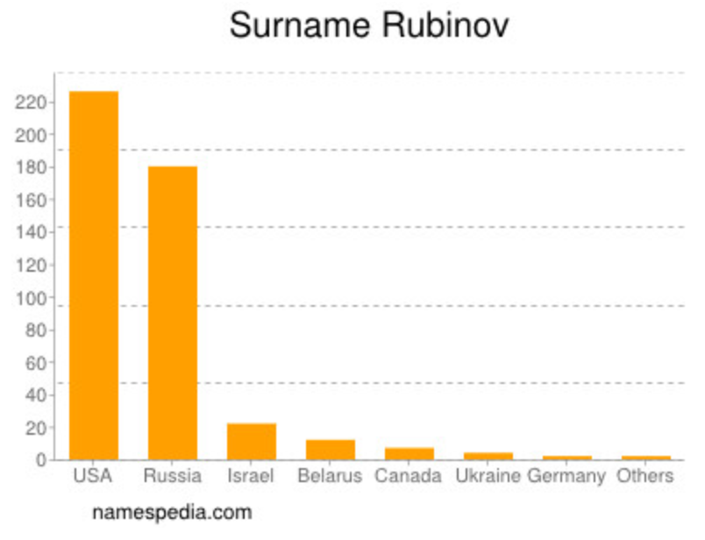
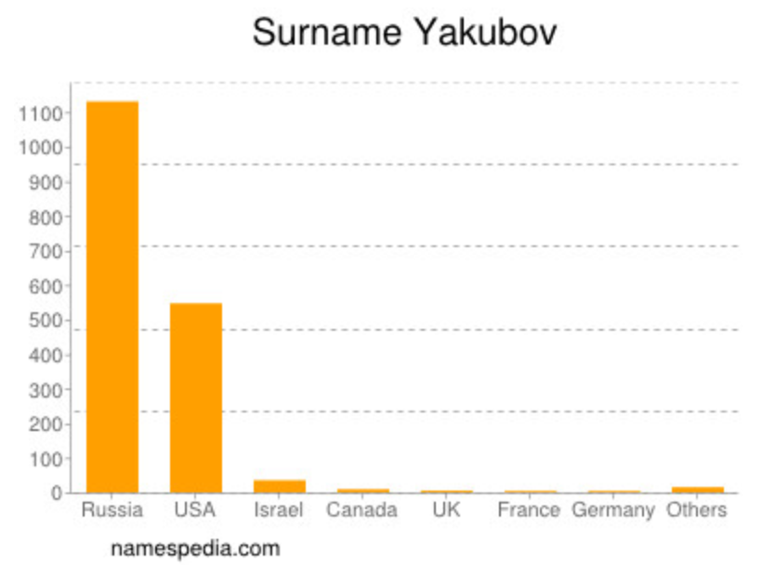
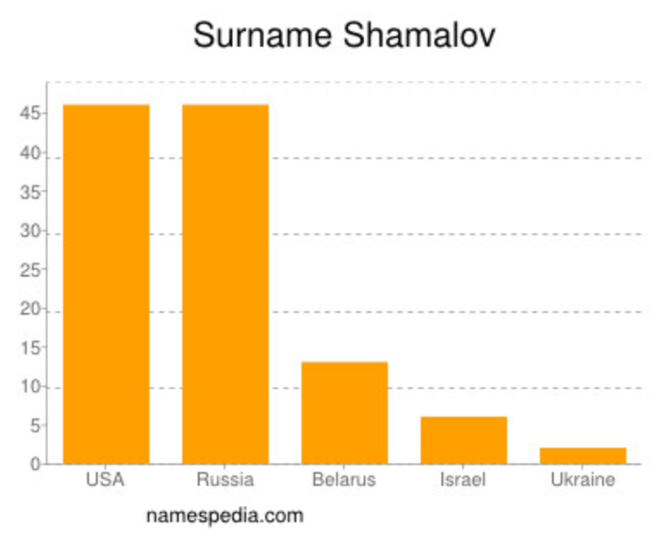
SE1634478 and other close (>75 cM) matches
dmashkabova@yahoo.com
torgovec5@mail.ru (Alexander Pinkhasov)
larisak7057@gmail.com (Larisa Gamburg)
mike.zavurov@gmail.com
yakov.rubinov@gmail.com (Yakov Rubinov)
vortexmikey@gmail.com (Michael Yakubov)
esuleymanov00@stuy.edu (Ester S)
vlad.m.shamalov@gmail.com (Vlad Shamalov)
michael.gavrilov10@stjohns.edu
Russian Jewish ethnic background?
https://www.name-doctor.com/name-mashka-meaning-of-mashka-14789.html

Slide 20
Bonus

Slide 21
RS386833395
A.k.a. 17:41276044, a.k.a BRCA1 185delAG
Frameshift mutation: two NTs are deleted, moving the entire “reading mechanism” by 2 NTs, resulting in an “inoperative” gene
Is associated with higher risk for
Breast / ovarian cancers in women
Prostate / general higher risk for cancers in men
Notes:
Based on:
"rs386833395 ... is a variant in the BRCA1 gene considered pathogenic for breast cancer ... "
"About 13% of women in the general population will develop breast cancer sometime during their lives. By contrast, 55%–72% of women who inherit a harmful BRCA1 variant ... will develop breast cancer by 70–80 years of age ..."
"About 1.2% of women in the general population will develop ovarian cancer sometime during their lives. By contrast, 39%–44% of women who inherit a harmful BRCA1 variant ... will develop ovarian cancer by 70–80 years of age ..."
"The most common malignancy was prostatic adenocarcinoma identified in 7/93 patients with BRCA1 mutation (8%) ..."
1 https://www.snpedia.com/index.php/Rs386833395
2 https://www.cancer.gov/about-cancer/causes-prevention/genetics/brca-fact-sheet
3 https://www.auajournals.org/doi/full/10.1016/j.juro.2017.02.385

Slide 22
RS386833395
Mutation frequency among Europeans
(1) Non-Ashkenazi Jews, non-Finnish Europeans: 11/128780 ≈ 85.42e-6
Finns: 0/25112 ≈ 0
(We'd expect ≈ 85.42e−6 × 25,112 ≈ 2 had they the same genetic properties as group (1))
Ashkenazi Jews: 42/10368 ≈ 4050.93e−6
(We'd expect ≈ 85.42e−6 × 10,368 ≈ 1 had they the same genetic properties as group (1))
Notes:
Based on:
"rs386833395 ... is a variant in the BRCA1 gene considered pathogenic for breast cancer ... "
"About 13% of women in the general population will develop breast cancer sometime during their lives. By contrast, 55%–72% of women who inherit a harmful BRCA1 variant ... will develop breast cancer by 70–80 years of age ..."
"About 1.2% of women in the general population will develop ovarian cancer sometime during their lives. By contrast, 39%–44% of women who inherit a harmful BRCA1 variant ... will develop ovarian cancer by 70–80 years of age ..."
"The most common malignancy was prostatic adenocarcinoma identified in 7/93 patients with BRCA1 mutation (8%) ..."
1 https://www.snpedia.com/index.php/Rs386833395
2 https://www.cancer.gov/about-cancer/causes-prevention/genetics/brca-fact-sheet
3 https://www.auajournals.org/doi/full/10.1016/j.juro.2017.02.385

Slide 23



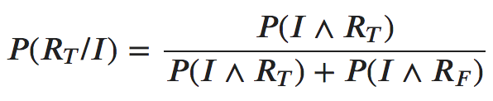

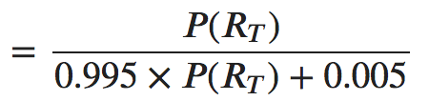

Having a mutation vs being identified as having a mutation
Identified as has
Actually has
Identified as doesn’t have
…
Identified as has
Actually doesn’t have
Identified as doesn’t have

Slide 24
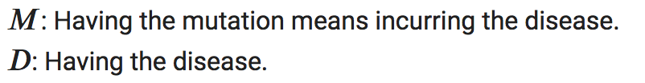
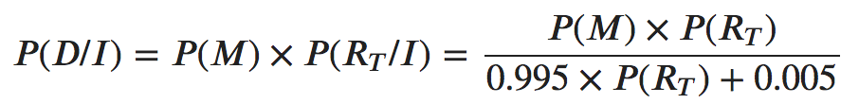
Mutation = Sick?
In other words: P(Sick/Mutation) = 100%?
No. Every sickness has its own P(Sick/Mutation).

Slide 25

RS386833395 - Example
Assuming:
The person is Non Finnish, non AJ, European
The person is a woman
The mutation is as prevalent in men as it is in women
The probability having the mutation identified is: 85.42e−6
So the probability of actually having the mutation given its identification is:

Slide 26



RS386833395 - Example
Wait, what? 1.68%? Yes (depends heavily on the probability to have the mutation).
To be more certain, we could another test: FP 0.005 → 0.000025 ⇒
3 Tests would give us:
Back to our example - using the mean value for breast cancer in women with this mutation (63.5%), and doing only 1 test:

Slide 27
RS386833395 - Example
Wait, what? 1.68%? Yes (depends heavily on the probability to have the mutation).
To be more certain, we could another test: FP 0.005 → 0.000025 ⇒
3 Tests would give us:
Back to our example - using the mean value for breast cancer in women with this mutation (63.5%), and doing only 1 test:

Slide 28
Questions?

Slide 29
Thank you!

